Slide 1
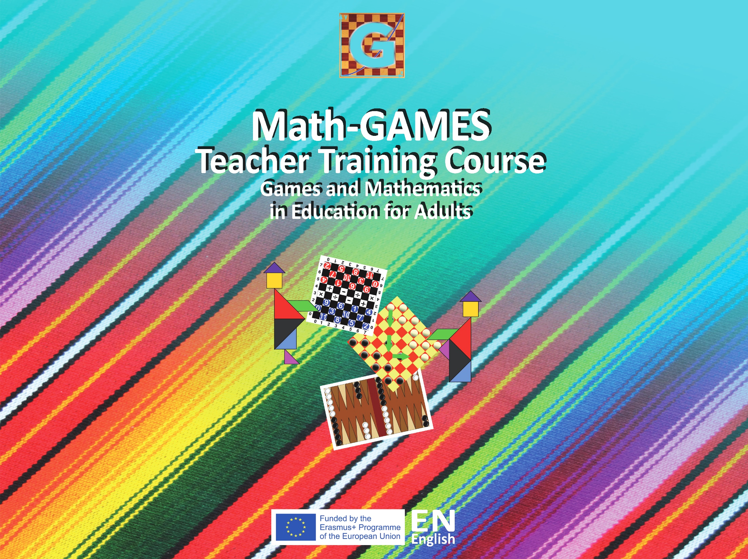

Slide 2
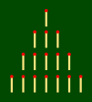
Nim Game Lesson1
Compendium , page 173
Guidebook , page 127
THE LESSON
Lesson Title: NIM lesson1 | Date: 28-03-2018
Length of the Lesson: 45 minutes | Teacher: Cristina and Helmut
HOW DOES THIS LESSON CONNECTS TO PREREQUISITES?
Target group: Seniors with basic skills in Maths, some of them very handicaped Be sure the participants recognize, read and write the numbers 0 to 10
Organization: 2 Teams of 4-6 people, 2 of them handicaped 2 teachers
LESSON OBJECTIVES (At the end of this lesson, students will be able to)
Count up to 10
Add single-digit numbers with totals to 10
Subtract single-digit numbers from numbers up to 10
MATERIALS
16 sticks or any other object like matches, pencils, toothpicks… Sheet with the pattern on paper, blackboard…

Slide 3
5
MINUTES
Nim Game Lesson1
OVERVIEW
How will students know the purpose for this lesson?
Get attention with a little performance:
We give 1 stick to each student, then you ask:
What to do with this stick?
(The seniors response)
After that, teacher says:
Would you like to play a game?
Are you able to put the sticks like this on the sheet?
(The pattern is on the table)

Slide 4
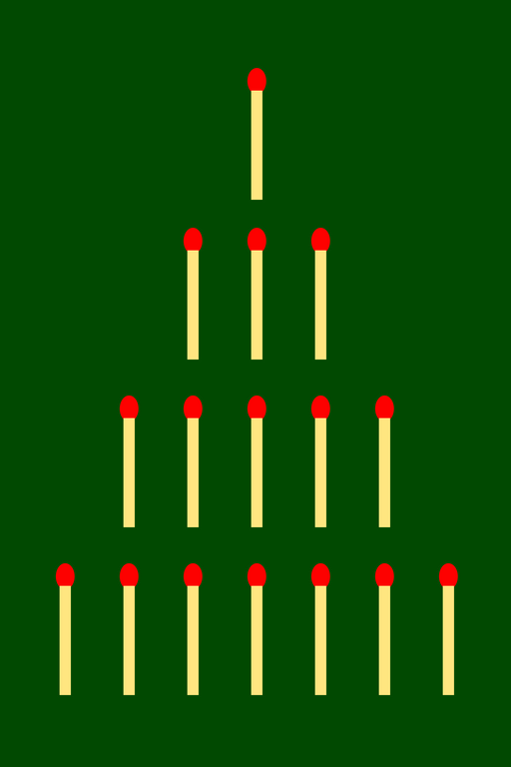
Nim Game Lesson1
Initial Pattern

Slide 5
Nim Game Lesson1
WARM UP
This game has been played since ancient times. The game is said to have originated in China, it closely resembles the Chinese game of Tsyan-shizi or "picking stones", but the origin is uncertain. Games of this sort seem to be widely played the world over.

Slide 6
10
MINUTES
Nim Game Lesson1
HOW TO PLAY
Nim is a mathematical game of strategy in which two players take turns removing objects from distinct rows from the initial pattern.
On each turn, a player must remove at least one object, and may remove any number of objects provided they all come from the same row.
Win who doesn’t take the last object.

Slide 7
Game Lesson1
LET’S PLAY THE GAME
Player A
Player B
Player B remove the last match…
Player A win the game!!

Slide 8
10
MINUTES
Nim Game Lesson1
GUIDED PRACTICE
Organize the students in 2 teams of 4-6 people, 2 of them handicaped
1 teacher in each team.
They play several times for learning how to play…

Slide 9
20
MINUTES
They fill the worksheet
while playing
PLAYER A / B
Movement | Taken sticks | Left sticks | Sum

Slide 10
Nim Game Lesson1
CONCLUSION / EVALUATION
Teachers evaluate the students by observation during the lesson using an evaluation sheet, taking in account the SEN.
In the next Lesson, they should be able to play the game by themselves and even to change the rules.
They also should be able to organize themselves counting the members and making teams solving problems.

Slide 11
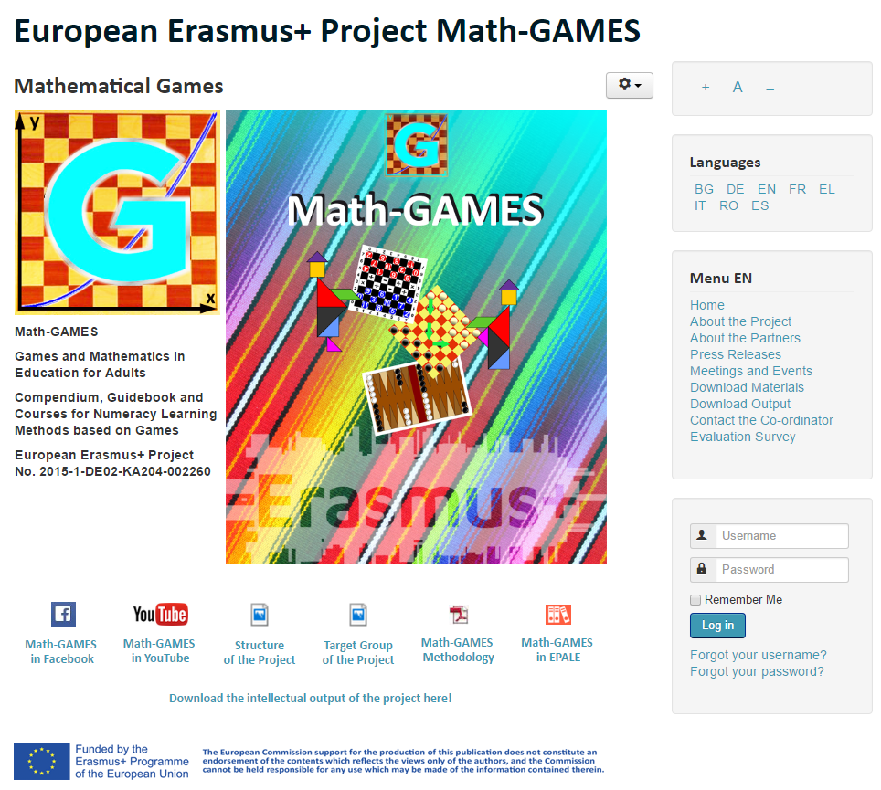
The result is: Play Games and learn Mathematics more easily.
Our Project-Website will help you: www.math-games.eu

